Slide 1

Predicting Interview’s Attendance By Implementing Naïve Bayes Technique Using Big Data Programming With Hadoop
by
Aniruddha Sadhukhan Regd. No.: 151170110009 of 2015-16 University Roll No. : 11700115009 | Sudipta Sarkar Regd. No.: 151170110085 of 2015-16 University Roll No. : 11700115084
B. Tech (CSE) – 7th Semester, 2018, RCCIIT Under the supervision of Mr. Titas Roy Chowdhury Course Coordinator, Globsyn Finishing School

Slide 2
DESCRIPTION OF THE JOB
We were given a dataset including various fields like client name, gender, location, answers to various questions asked over phone etc.
Based on this we have to predict the real appearance of candidates in the interview.

Slide 3
TECHNIQUE USED
We have used Naïve Bayes supervised machine learning to predict the appearances in this project.
Naive Bayes is a simple but surprisingly powerful algorithm for predictive modeling.
Naive Bayes is called naive because it assumes that each input variable is independent. This is a strong assumption and unrealistic for real data, nevertheless, the technique is very effective on a large range of complex problems.

Slide 4
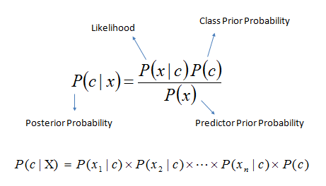

Slide 5
Hardware and software requirements
HADOOP CLUSTER IS USED WHICH IS MADE OF COMMODITY HARDWARE
Master’s recommendation
4–6 1TB hard disks
(1 for OS [RAID 1], 2 for the FS image [RAID 5/6], 1 for JournalNode)
2 CPUs(8-12 cores per CPU), running at least
2-2.5GHz
128-512GB of RAM
Bonded Gigabit Ethernet or 10Gigabit Ethernet

Slide 6
SLAVE’S RECOMMENDATION
12-24 1-4TB hard disks in a JBOD (Just a Bunch Of Disks) configuration
2 CPUs(8-12 cores per CPU), running at least
2-2.5GHz
64-128GB of RAM
Bonded Gigabit Ethernet or 10Gigabit Ethernet

Slide 7
SOFTWARE
Hadoop 2.2.0 or above runs well on Linux operating systems like: RedHat Enterprise Linux (RHEL), CentOS, Ubuntu
Hadoop is written in Java. The recommended Java version is Oracle JDK 1.6.31

Slide 8
SOURCE AND DESCRIPTION OF DATA
THE DATA HAS BEEN PROVIDED BY THE INSTITUTE
THE DATA CONSISTS OF 23 DISCRETE SPECIFICATIONS WHICH INCLUDES 1234 NUMBER OF RECORDS
TYPES OF SPECIFICATIONS:
DATE OF INTERVIEW-The date on which the interview is going to take place
CLIENT NAME-Name of the company
INDUSTRY-The type of industry concerned ('Electronics' 'Telecom' 'IT' )
LOCATION-Location of the company ('Delhi' 'chennai‘)
POSITION TO BE CLOSED-The post offered(Production- Sterile' 'Selenium testing‘)
NATURE OF SKILL SET-skill required for the job('Routine' 'Oracle' )
INTERVIEW TYPE-Type of interview(Walk in, scheduled, scheduled walk in)
NAME-Candidate Id
GENDER
CANDIDATE CURRENT LOCATION-Present address of the candidate
CANDIDATE JOB LOCATION-Where the candidate will be working
INTERVIEW VENUE
CANDIDATE NATIVE LOCATION

Slide 9
HAVE YOU OBTAINED THE NECCESSARY PERMISSION TO START AT THE REQUIRED TIME-
May be yes , no or not yet
HOPE THERE WILL BE NO UNSCHEDULED MEETINGS- TIME-May be yes , no or not yet
CAN I CALL YOU THREE HOURS BEFORE THE INTERVIEW AND FOLLOW UP ON YOUR ATTENDANCE FOR THE INTERVIEW- TIME-
May be yes , no
CAN I HAVE AN ALTERNATIVE NUMBER/DESK NUMBER-
Yes or no
HAVE YOU TAKEN A PRINT OUT OF YOUR UPDATED RESUME-
yes or no or NA
ARE YOU CLEAR WITH THE VENUE DETAILS AND THE LANDMARK-Yes or no or need to check or not sure
HAS THE CALL LETTER BEEN SHARED-
Yes or no or haven't checked
EXPECTED ATTENDANCE-
uncertain, yes or no
OBSERVED ATTENDANCE-
yes or no
MARITAL STATUS-
single or married

Slide 10
DATA CLEANSING
Rows in which some data were missing or all the 23 data weren’t present are ignored
Some data included incorrect punctuation marks or non word characters and are rectified
Some values were nearly similar(e.g: liaison and liabilities, liaison & liabilities, liaison liabilities)and were changed to a single value
Rows where some discrepancy in data was there were rectified

Slide 11
DATA PROCESSING Concept of Map-Reduce has been used to process the data. Three jobs have been used namely:- IA:: MAPPER AND 3 REDUCERS TEST:: MAPPER AND NO REDUCER ANALYSIS:: MAPPER AND 1 REDUCER

Slide 12
Work Flow Diagrams
DATASET
data provided by the institute
IA Job(Map-Reduce)
Cleansing the given dataset and converting nearly similar values to a single value.
Generates count for each unique values of dependent variables given the appearance, which is used to calculating prior and likelihood probabilities
FIRST OUTPUT
stores the counts calculated in the IA Job.
Probabilities can be calculated by simply one division and is done during actual prediction for greater accuracy

Slide 13
TEST Job
predicts the attendance of all the candidates given in the dataset using the learned probabilities and also compares with the observed output.
SECOND OUTPUT
stores for each candidate, the predicted attendance and observed attendance and if they matches
ANALYSIS Job (Map-Reduce)
Calculates the conclusion matrix and also the accuracy of the model.
FINAL OUTPUT
Stores the conclusion matrix and also accuracy of the model as calculated by the analysis Job.

Slide 14
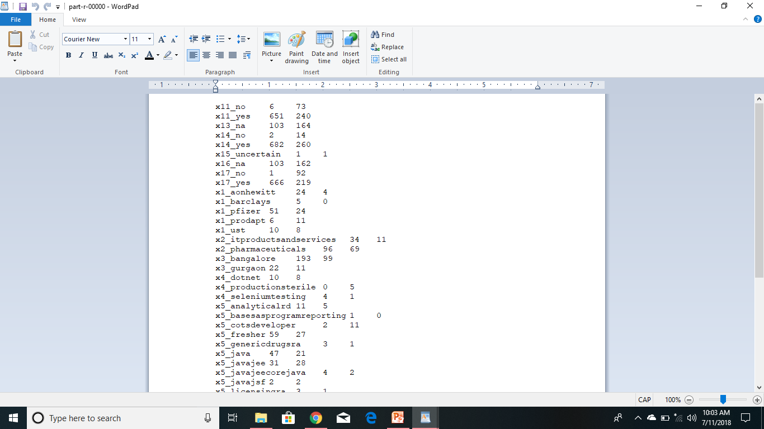
OUTPUT
Output of IA job

Slide 15
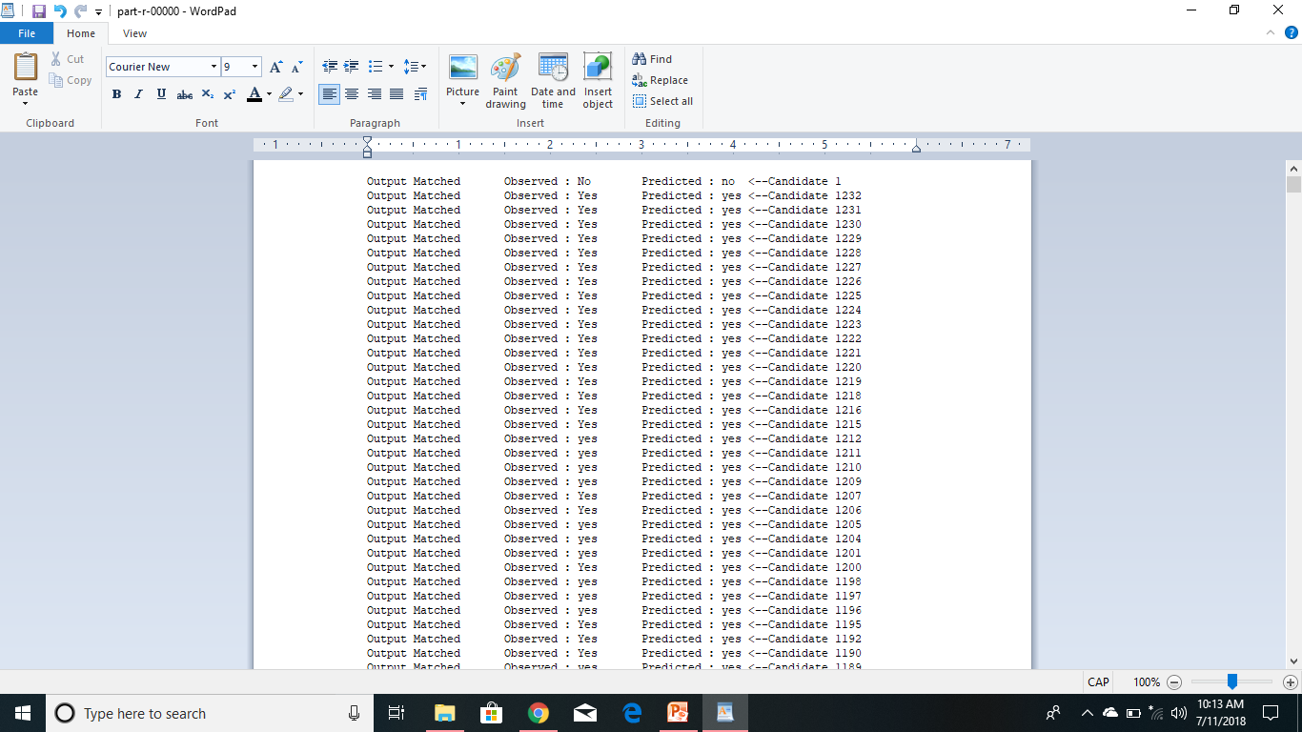

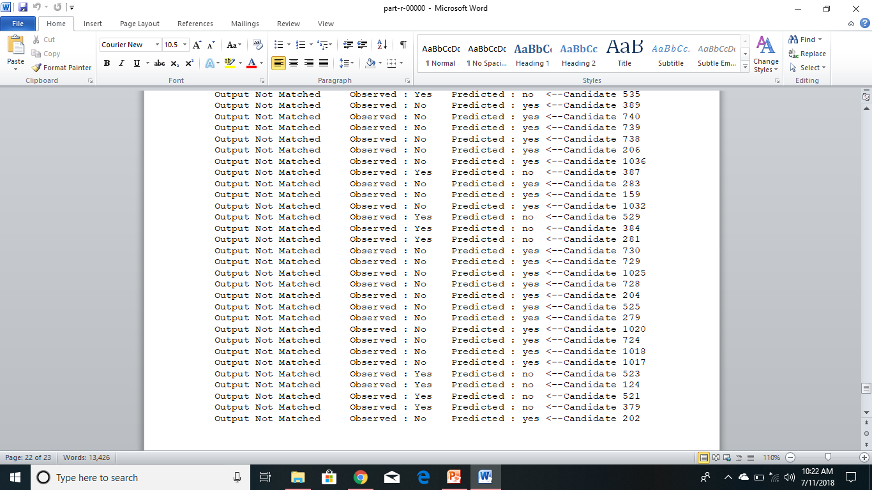
Output of Test Job

Slide 16
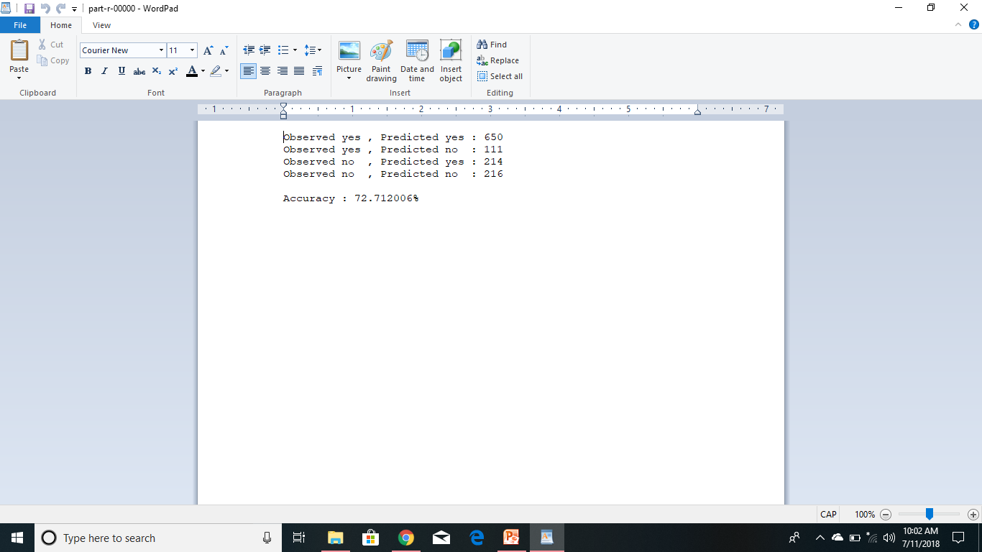
Output of Analysis Job(Final Output)

Slide 17
FUTURE IMPROVEMENT The prediction analysis has been done based on a batch processing system instead of a real time system. For further improvement this has to be transformed into real time system using Apache Spark.

Slide 18
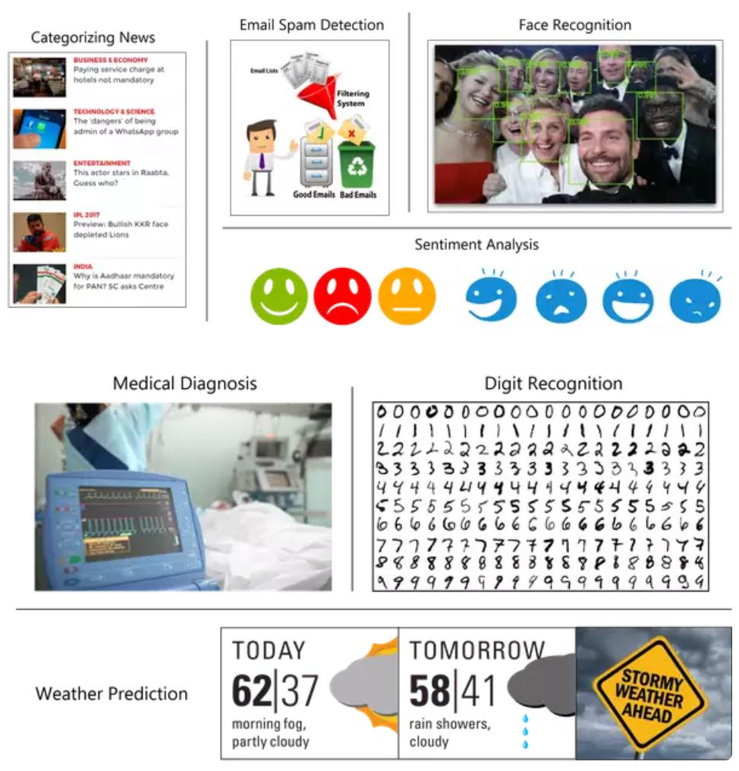
This Naïve Bayes approach using MapReduce can be used similarly in many other applications: Churn Detection  Vote Prediction  Email Spam Detection  News article categorization  Sentiment Analysis  Facial recognition  Handwriting Recognition  Weather Prediction
APPLICATION

Slide 19
CONCLUSION
From a given data set, we have calculated the conditional probability for each value of the dependent attributes given the appearance of the candidates using Naïve Bayes supervised machine learning. After that we have predicted the candidate appearance and cross checked with the observed appearance and we have got a satisfactory 73% accuracy. So we can say that this application is working as expected.

Slide 20


